Slide 1
StartUp Idea Validator Using LLM
K.Harshitha N200373

Slide 2
Abstract
An AI-powered tool that evaluates startup ideas using Large Language Models (LLMs). It takes natural language input and generates structured insights like market potential, competitor analysis, SWOT, monetization strategies, and MVP features. Built with Python and Streamlit, it uses prompt engineering to interact with LLM APIs and deliver real-time, actionable business analysis. This project showcases AI’s role in early-stage startup validation, business planning, and decision support.

Slide 3
Motivation
Validating startup ideas is a critical yet challenging step for early-stage entrepreneurs, especially those without access to expert analysts or market research resources. Traditional validation methods are time-consuming and require domain expertise, often leading to abandoned ideas or poorly executed ventures. This project addresses that gap by proposing an AI-powered Startup Idea Validator that uses Large Language Models (LLMs) to analyze user-submitted ideas and provide structured insights like SWOT, market potential, monetization strategies, and competitor analysis. It empowers founders to make informed decisions quickly, reducing risk and democratizing access to business validation.

Slide 4
Proposed Model &Workflow
The Startup Idea Validator follows a lightweight client-server architecture using hosted LLMs and consists of four main modules:
User Interface (Streamlit)
Takes natural language input of startup idea
Displays structured feedback to the user
Prompt Engineering
Transforms user input into a structured prompt
Specifies desired outputs (e.g., Market, SWOT, Competitors, Monetization, MVP)
LLM Interaction
Sends prompt to LLM API (e.g., HuggingFace/OpenAI)
Receives analysis as structured response
Output Display & Parsing
Formats and shows LLM response on UI
System Workflow
User inputs idea → Prompt formatted → Sent to LLM → Receives insights → Parsed and displayed in UI.

Slide 5
Large Language Model
LLM stands for Large Language Model which is an AI system trained on massive amounts of text data (books, articles, code, websites, etc.) to understand and generate human-like text.
Examples: GPT (like me), LLaMA, Claude, Gemini.
They are called “large” because they have billions or even trillions of parameters (weights inside a neural network that capture patterns of language).
LLMs are built on the Transformer architecture (Vaswani et al., 2017).
“Attention is all you need” Paper.
Key idea is Self-Attention mechanism → allows the model to look at all words in a sentence at once, and figure out which words matter most in context
Unlike older models (RNNs, LSTMs), Transformers can process text in parallel, making training much faster and scalable.

Slide 6
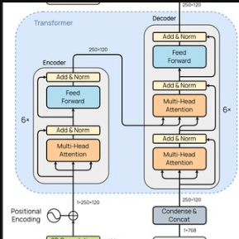
Transformer Architecture
Proposed in “Attention Is All You Need” (Vaswani et al., 2017).
Replaced RNNs/LSTMs by processing all words in parallel instead of sequentially.
Uses Attention Mechanism to capture context between words, no matter how far apart.

Slide 7
Input Representation
Raw text → Tokenization → Embeddings.
Each word is mapped to a high-dimensional vector.
Positional Encoding is added, since Transformers don’t process words in order naturally.
Encoder–Decoder Structure
Original Transformer had Encoder + Decoder (for translation tasks).
Encoder :Processes the input sequence via stacked layers—each with self-attention and feed-forward sublayers—to generate contextual embeddings.
Decoder:Generates the output sequence one token at a time using masked self-attention, cross-attention (to encoder outputs), and feed-forward layers
Most LLMs today (like GPT) use Decoder-only stacks (for generation).

Slide 8
Multi-Head Self-Attention
Self-Attention: For each word (token), calculate its relation to every other word.
Mechanism:
Every token is converted into three vectors:
Query (Q) = What am I looking for?
Key (K) = What do I have?
Value (V) = What is my meaning?
Attention Score = similarity(Q, K).
Weighted sum of V = Context for each word.
Multi-Head Attention: Do this in parallel multiple times, so the model can capture different relationships (syntax, semantics, long-range dependencies).

Slide 9
Feedforward Network
After attention, each word’s representation passes through small neural networks (same for all words).
Helps refine and add non-linearity
Residual Connections & Layer Normalization
Each sub-layer has a skip connection (output + input) → prevents information loss.
LayerNorm stabilizes training and improves performance.
Stacking Layers
Transformers use many such layers stacked (12, 24, 96+).
Lower layers capture local meaning (e.g., “food ↔ waste”), higher layers capture abstract concepts (e.g., “sustainable business model”).
Output Layer
Final vector representations go to a Softmax classifier → predicts probability distribution over the vocabulary.
The model generates one token at a time until a full response is formed.

Slide 10
Mistral 7B Instruct LLM
Open-Source & Lightweight → 7B parameters, efficient but powerful.
Fast Inference → Sliding Window Attention & Grouped-Query Attention optimize speed.
High-Quality Reasoning → Performs competitively with larger models on many tasks.
Cost-Effective → Cheaper to run than GPT-4/Claude → practical for startups.
Flexibility → Easy to integrate via API + suitable for prompt engineering.

Slide 11
Workflow
User Input: Founder types a raw idea in plain English and tune this input into prompt using prompt techniques and the tuned prompt is given as input to LLM via API
Tokenize & Embed: Text → tokens → numerical vectors (embeddings) for meaning.
Understand (Transformer)
Self-Attention weighs relationships across all words
Multi-Head captures different patterns (semantics, position, dependencies).
Stacked Layers build from surface meaning → business concepts.
Generate: Next-token prediction produces structured insights:
SWOT · Competitors · Monetization · MVP features · Market notes.
Parse & Display: Output is parsed into sections and shown in the Streamlit UI for clear, actionable results.

Slide 12
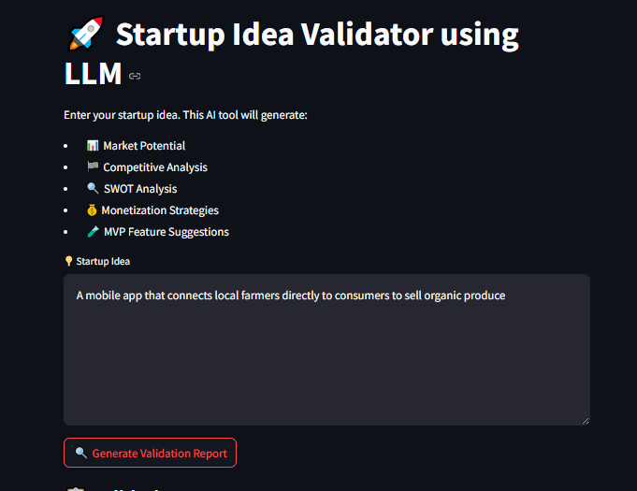

Slide 13
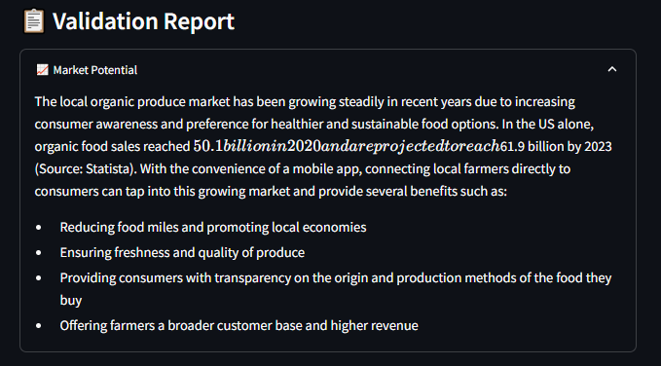

Slide 14
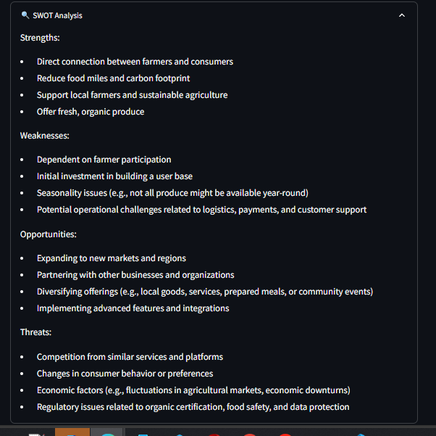

Slide 15
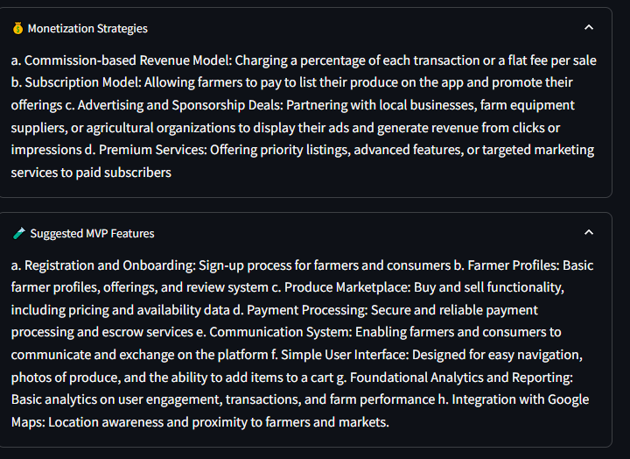

Slide 16
Evalaution and Challenges
Strengths
Quick, accessible, structured insights
Works for any domain (tech, healthcare, sustainability).
Limitations:
May produce generic or hallucinated outputs.
No real-time market data integration (yet).
Lacks domain-specific fine-tuning.
Evaluation: Tested with 10–15 startup ideas → feedback showed useful but sometimes repetitive results.

Slide 17
Conclusion
The proposed Startup Idea Validator system leverages the capabilities of Large Language Models (LLMs) to assess, analyze, and provide structured feedback on user-submitted startup ideas. By integrating prompt engineering, API-based LLM interactions, and a user-friendly web interface, the system can evaluate ideas on parameters like market potential, competitor landscape, monetization strategies, and MVP features. This eliminates the need for extensive manual research and supports entrepreneurs in the early validation phase. The system demonstrates the potential of generative AI in the startup ecosystem and highlights how LLMs can automate knowledge-based analysis across domains.

Slide 18
Future Scope
Fine-Tuning Domain-Specific LLMs: Future enhancements can include training or fine-tuning LLMs on startup and entrepreneurial datasets (e.g., Crunchbase, YCombinator pitches, etc.) to improve output relevance and reduce generic responses.
Multi-Language Support: Incorporating multilingual capabilities using translation APIs or multilingual models (like mBERT or XLM-R) to support idea validation in regional languages, thus expanding accessibility to non-English users.
Integration with Real-Time Data Sources: Enhancing validation by integrating APIs like Google Trends, AngelList, and LinkedIn to provide up-to-date competitor analysis and market signals.
Feedback Loop and Reinforcement Learning: Implementing a feedback mechanism where user ratings of LLM suggestions are used to refine future responses via reinforcement learning or prompt tuning.
Idea Feasibility Scoring System: Introducing a quantifiable scoring mechanism that evaluates startup ideas based on AI-evaluated metrics such as innovation level, market readiness, and risk factors.

Slide 19
Thank You

